Slide 1

C/C++ Basics
Introductory class

Slide 2
Table of contents Agenda
A short history of C and C++
Where are C and C++ used?
Motivation: software development with C++
Compilation process overview
Common errors: tips and tricks to fix them
References
Author

Slide 3
A short history
C and C++ are not dead, they are “living” languages
Year | Event
1972 | Development of C started.
1978 | First informal language specification (K&R)
1979 | Development started on “C with classes”
1983 | “C with classes” is renamed to “C++” Some people still treat C++ as just basically just “C with classes”.
1985 | First reference of C++
1989 | C89 ANSI Standard (American National Standards Institute)
1989 | C++ 2.0 (minor additions, still informal)
1990 | C90 ISO Same as C89, but standardized by ISO
1970 |  |  |  |  |  |  |  |  |  | 1980 |  |  |  |  |  |  |  |  |  | 1990
 | 71 | 72 | 73 | 74 | 75 | 76 | 77 | 78 | 79 | 80 | 81 | 82 | 83 | 84 | 85 | 86 | 87 | 88 | 89 | 90 | 91
Notes:
The history of C and C++ is provided here to help you understand that you will encounter some drawbacks and why that is.

Slide 4
A short history
C and C++ are not dead, they are “living” languages
Year | Event
1998 | First ISO standardized C++ version (C++98)
1999 | C99 (ISO)
2003 | C++03 (ISO) Minor fixes to the standard.
2011 | C++11 (ISO) Major update
2011 | C11 (ISO) Major update
2014 | C++14 (ISO) - Minor update
2017 | C++17 Major update
 |  |  | 2000 |  |  |  |  |  |  |  |  |  | 2010
97 | 98 | 99 | 0 | 01 | 02 | 03 | 04 | 05 | 06 | 07 | 08 | 09 | 10 | 11 | 12 | 13 | 14 | 15 | 16 | 17
Notes:
The history of C and C++ is provided here to help you understand that you will encounter some drawbacks and why that is.

Slide 5
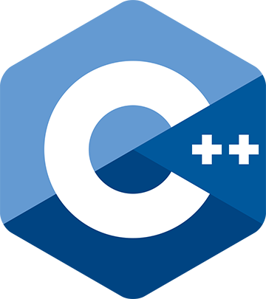
A short history
Things to remember
C and C++ are different.
There are different standards, and different versions of them
C++98, C++03, C++11, C++14, C++17, C++20, C++23 under development
New standards are being published, so what you have learned or heard so far, may no longer be valid.
When you search for something on the web, keep in mind that you may find something that is written for a newer or an older standard (or by someone who only knows a newer or an older standard).
More information on https://isocpp.org

Slide 6
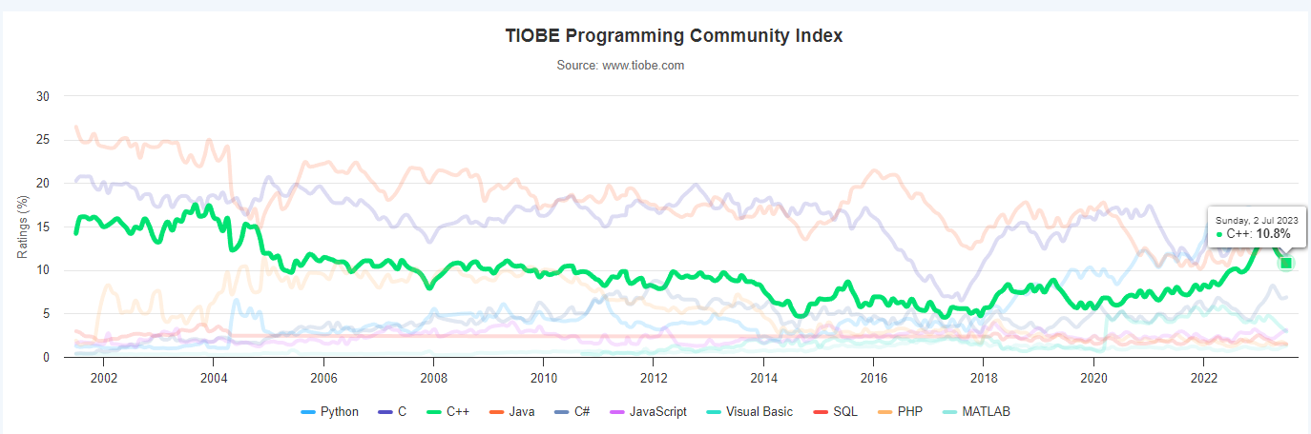
A short history - popularity
http://www.tiobe.com/index.php/content/paperinfo/tpci/index.html

Slide 7






Where are C and C++ used?
Why would anyone use C?
It uses a simple compiler, so it’s basically everywhere
It provides low-level access to memory
It is mapped efficiently to machine level instructions
Cross-platform and portable (from micro-controllers to supercomputers)
Used in:
System programming (C is the language of Unix).
Applications
Examples: Gimp, git, Qt
Game Engines: id Tech 1, 2, 3 (pre 2004)
Libraries/Utilities: cURL, SQLite, Lua

Slide 8





Where are C and C++ used?
Why would anyone use C++?
It can integrate directly a lot of C code
In practice, most languages are able to interact with C code.
It can do in theory everything that C does, while also providing some extra features (somewhat better text handling, OOP, templates, somewhat better memory management)
In practice, you need to be careful about what you mix. No feature is free.
Used in:
System programming (but much less than C).
Applications
Examples: Photoshop, Inkscape
Game Engines: Unreal Engine, idTech 4 (Doom 3 and later),
CryEngine, Anvil (Assassin’s Creed series), Source
SCADA systems: WinCC OA

Slide 9
Motivation: Software development with C++
When you develop a program, you follow a certain workflow
Define the problem to be solved. Most often underrated, but actually, the most important topic when we develop an application, provide motivation for the entire process.
Identify the solution. In practice, you need to be careful about what you mix. No feature is free.
Create the solution
Different parts of the solution can be written in different languages
(Code goes here: You don’t need to start coding right away)
Test the solution. Yes, really! Even if you think it works perfectly.
Deliver the solution.
Get feedback from the client, return to step 2 if necessary based on feedback received. It is also a very important step, even if you think your job is done.
Why ?
What ?
How ?

Slide 10
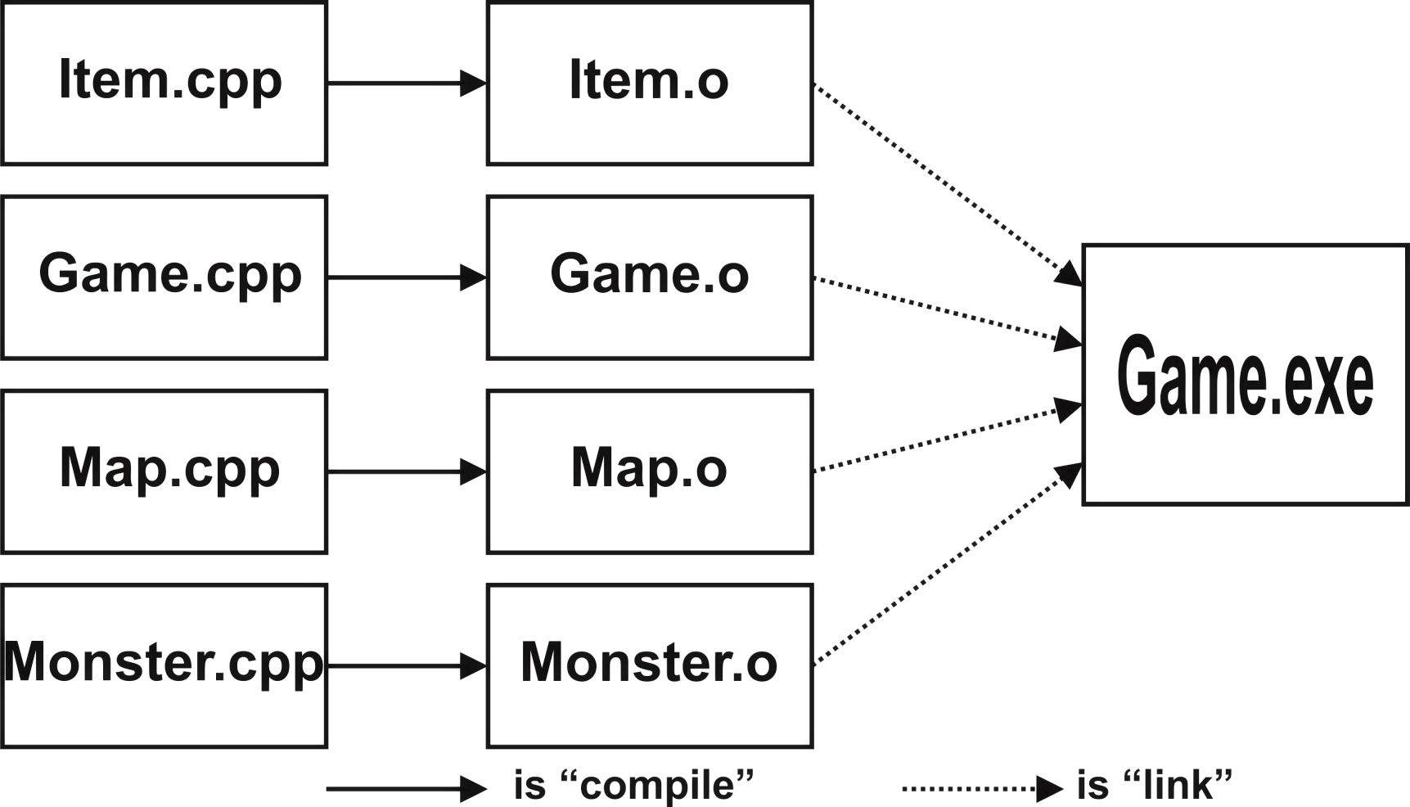
Software development with C++ from code to application
C++ is a compiled language. The typical steps to create a solution are presented below. (Based on what development environment and tool chain you are using, additional steps may apply).
Write code in source file(s)
Compile it
Link it
Profit
????
Most likely involves testing and delivering at some point

Slide 11
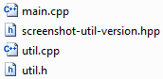
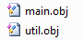
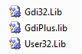
Software development with C++ from code to binaries and application
From code to deliverables in Visual C++
Source code
Intermediate object code
Binary result
Compiler
Linker
Libraries
Libraries
Libraries
Windows
SDK
Example: a small C++ application that performs screenshots
https://github.com/dezGusty/screenshot-util

Slide 12
Software development with C++ compilation process
More on compiling
Can consist of several different programs, depending on the used development environment
Source code
Object code
Compiling process
Parse code files
Parse characters to internal representation (E.g. from UTF to ASCII), join lines, strip comments
Preprocessing
Expand #includes, macros (#if …, #define, etc)
Translation
Concatenate strings, translate internal tokens to object code
Only source files are compiled directly, not headers

Slide 13
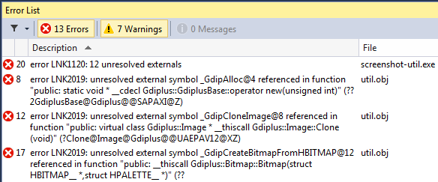
Software development with C++ common errors
“Why do I need to learn about this stuff?
I just need to hit <CTRL> + <F5> or <CTRL> + <SHIFT> + B and it works!”
Errors!
You will run into errors!
To fix them, you must understand what could cause them.
Common sources for errors:
Compilation errors (code does not compile)
Linking errors (code compiles)
Runtime errors (code compiles and links, application crashes)
Semantic errors (code compiles, links, application runs, but doesn’t do what was expected)

Slide 14
Software development with C++ common errors
Compilation errors
Code does not compile. Check the code (syntax, identifiers)
Linking errors
Code compiles, some used functions/objects cannot be located
Check the code, the project files, the referenced libraries
Runtime-fatal errors
Code compiles and links, application crashes
Check program flow, use of unallocated or destroyed data
Check used resources (E.g. file paths)
Runtime-logic errors
Code compiles, links, application runs, but doesn’t do what was expected
Check the code (E.g. infinite loop)

Slide 15
References
https://isocpp.org
https://en.cppreference.com
http://www.cplusplus.com
https://www.learncpp.com
MSDN: Phases of translation
https://msdn.microsoft.com/en-us/library/bxss3ska.aspx
Further reading on compilation process
https://medium.com/coding-den/the-compilation-process-a1307824d40e

Slide 16
Contact
Published by Siemens 2023
Ionuț Verzea
Software Engineer ADV D EU RO IFA MI
Blv. 15 Noiembrie Nr.78 500097 Brașov România
E-mail ionut.verzea@siemens.com

